Slide 1



AI Solar Roof Potential Analyzer: Revolutionizing Urban Solar Potential Assessment
Team name: Team CIFAR
Leader: Pranjal Srivastav
College: BITS Pilani
MAKING BHARAT A GREEN ……………..COUNTRY

Slide 2
The Urban Solar Challenge
Assessing solar potential in urban areas is crucial for sustainable development
Current methods are time-consuming and resource-intensive
Manual surveys and simplified estimations are often inaccurate
Large-scale implementation is impractical with traditional approaches
People remain unaware of the potential and financial benefits of Solar Energy
Need for an automated, scalable solution to assess rooftop solar potential across entire cities or regions

Slide 3
Introducing the AI Solar Roof Potential Analyzer
An innovative web application leveraging AI and computer vision
Automates the process of identifying suitable rooftops for solar panels
Provides accurate energy generation potential estimates
Offers actionable insights through an intuitive interface
Scalable for city-wide or regional assessments
Motivates people towards Renewable Energy

Slide 4
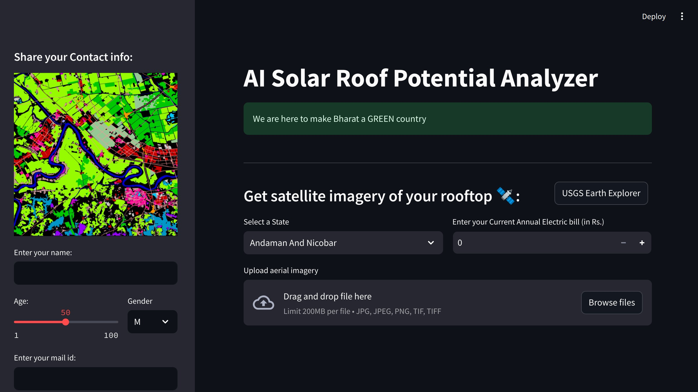

Slide 5
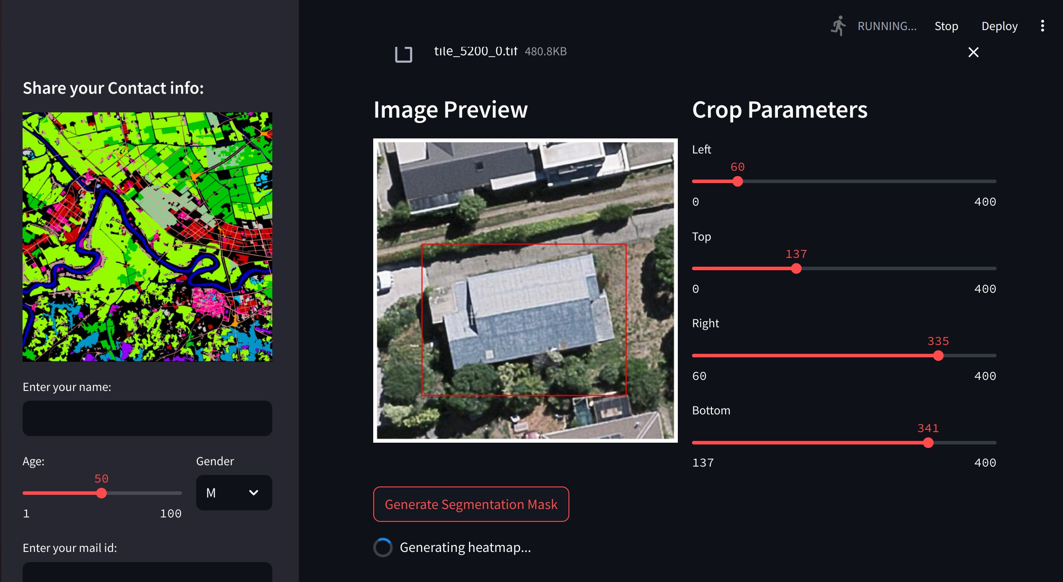
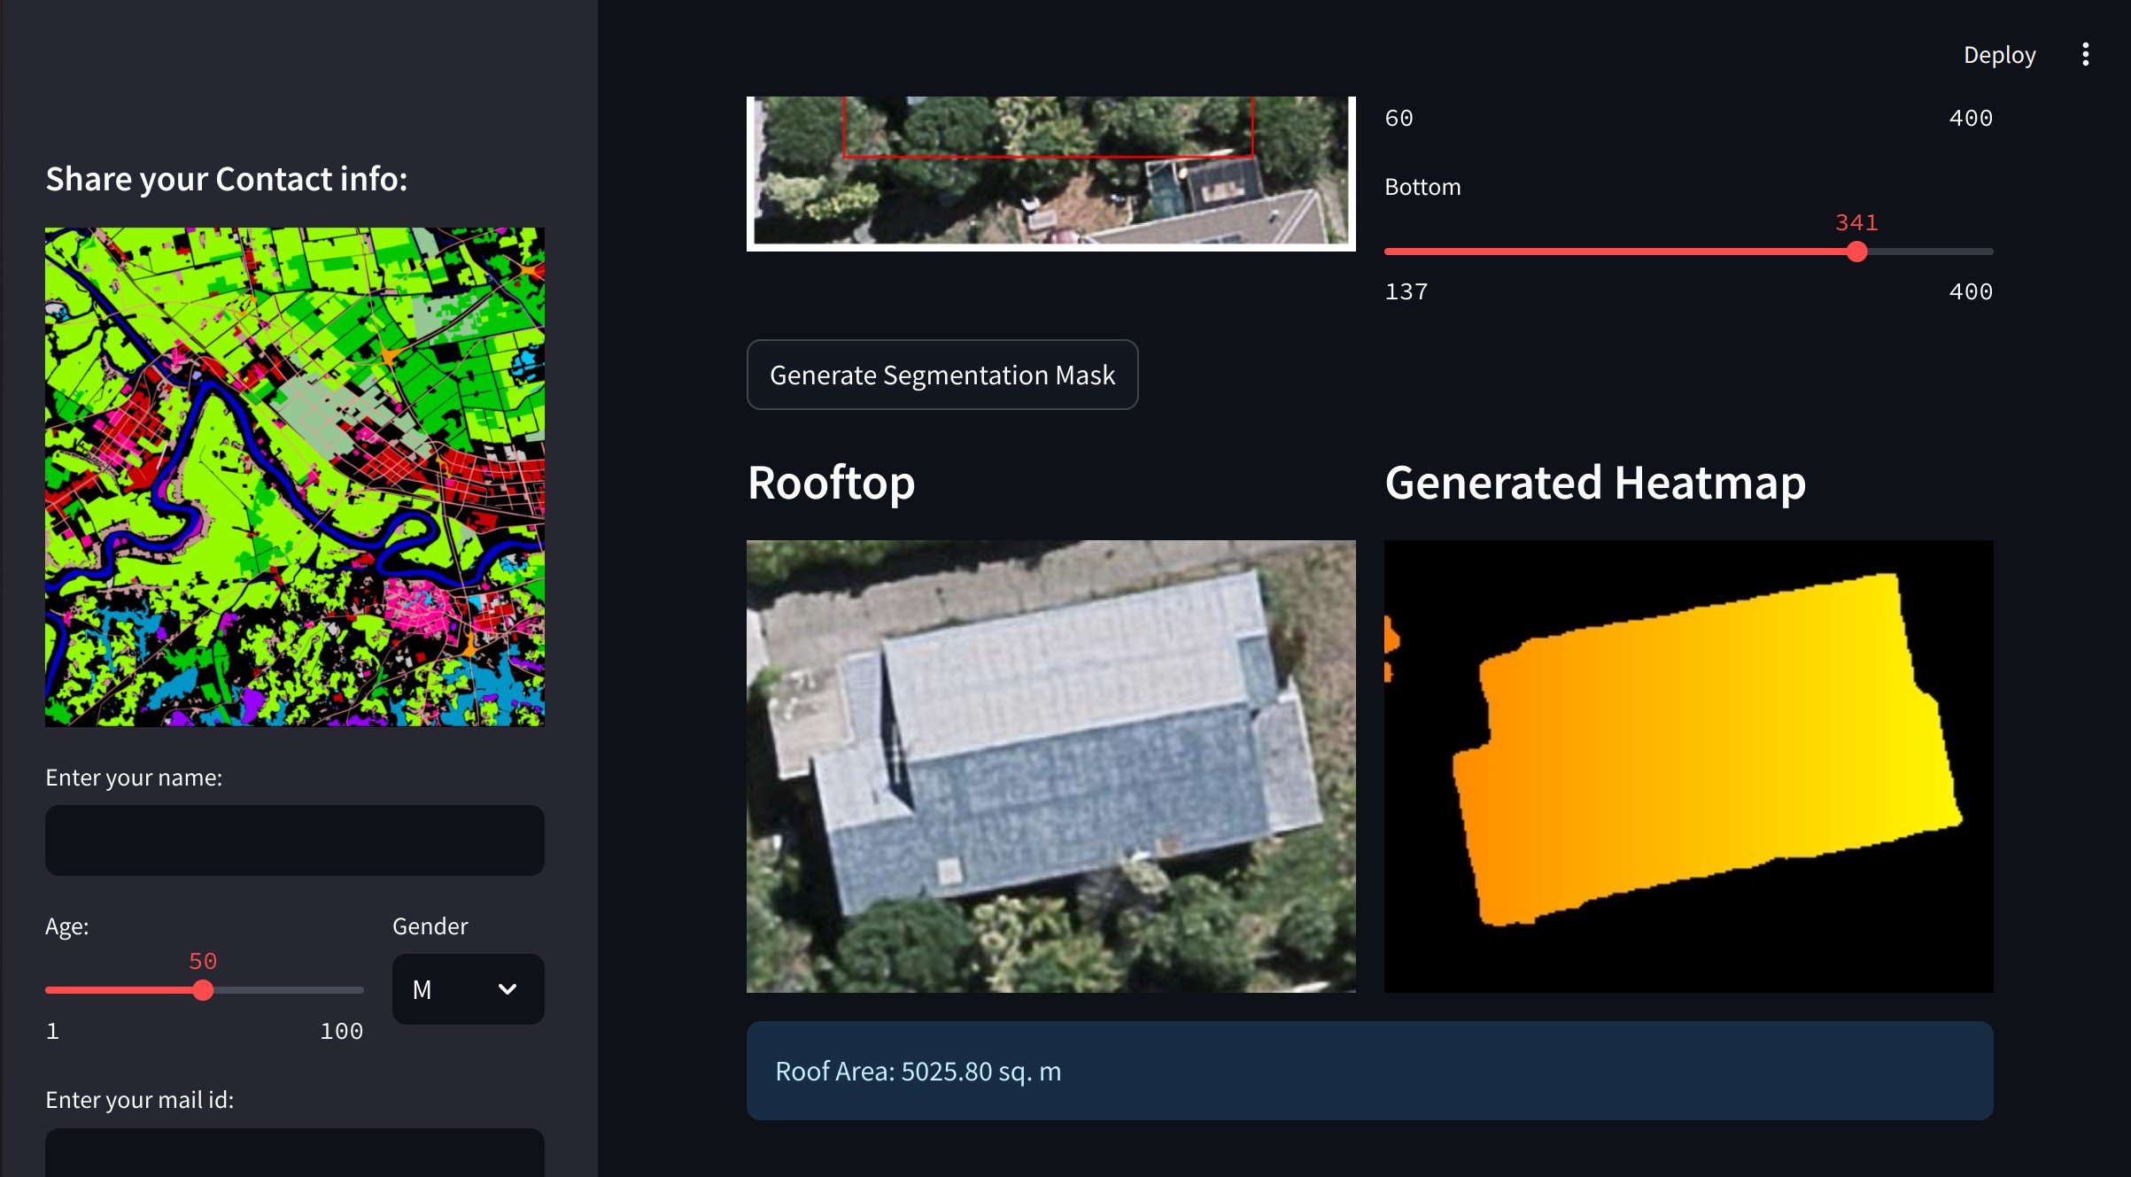
Core Technologies:
Building Footprint Extraction
U-Net architecture (PyTorch)
Precise semantic segmentation of satellite imagery
Roof Characteristic Analysis
Custom Vision Transformer (ViT) model
Extracts orientation and usable area
Solar Potential Calculation
Integrates roof data with location-specific solar irradiance + monthly avg temperature
Physics-based model for energy generation estimates

Slide 6
Empowering Solar Decisions
User-friendly Streamlit interface for easy image upload and analysis
Access to USGS Earth-Explorer satellite imagery data
Real-time integration of state-specific temperature and irradiance data
Comprehensive reports including:
- Monthly and annual energy production estimates
- Potential cost savings based on current electricity bills
- Visualizations of solar impact on energy costs
Customizable analysis with image cropping and parameter adjustments
Scalable from individual buildings to entire urban areas
Accelerates solar adoption by making assessment more accessible and accurate

Slide 7
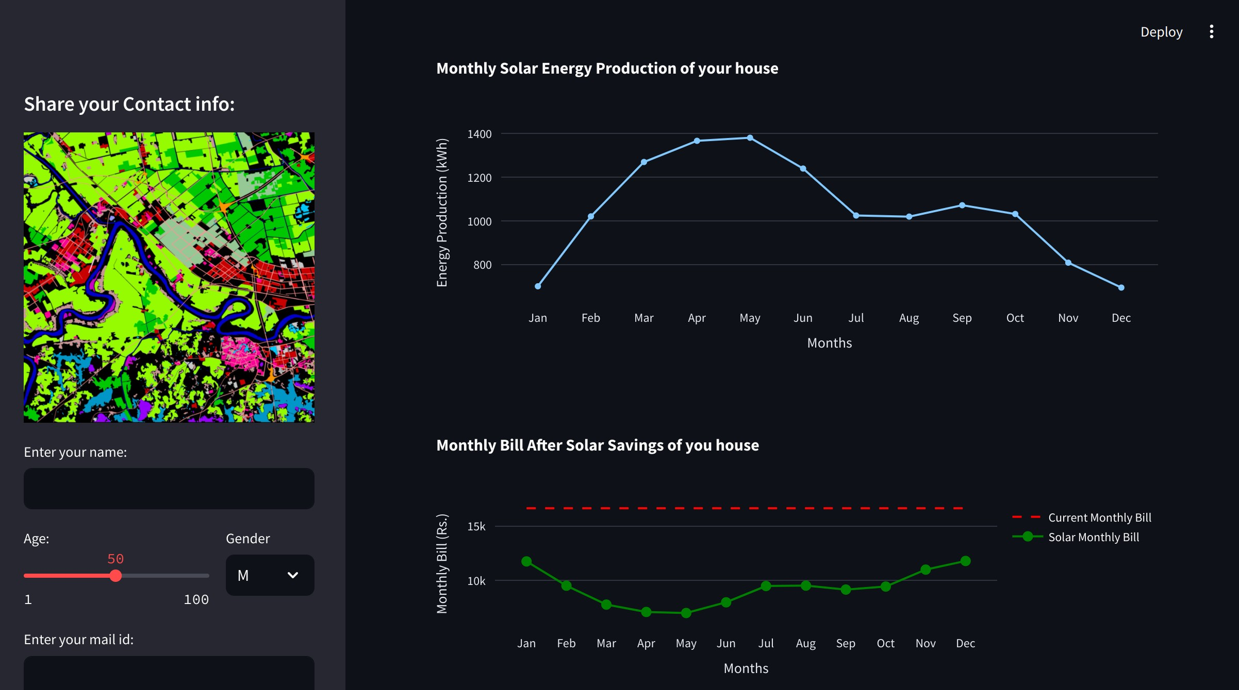
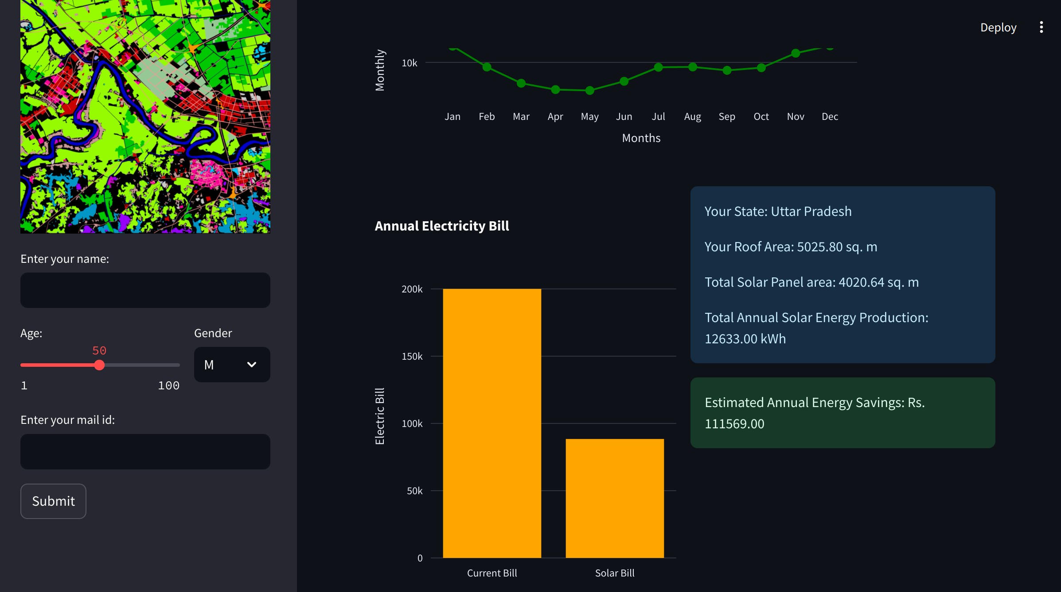

Slide 8

Thank you
Team CIFAR

